Slide 1
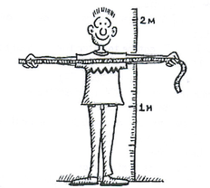
Measure your height and Arm span
Plot it on the scatter plot once you have the measurement
Notes:
Drawing a scatterplot as a class.
Draw up a set of axes on the whiteboard.
Show students how to plot the point on their using yourself as an Example (or Mr Morgan Height and arm span both 200cm)
When they measure their height and arm span they will then plot their data point on the scatterplot

Slide 2
24
7
30
Date
Scatterplots
EQ – how can we use scatterplots to analyse data?
Scatterplots compare how one variable is affected by another
Trend line or line of best fit
The trend line can be used for making predictions Extrapolation is a prediction ______________ the data
Interpolation is a prediction _______________ the data
Describing the relationship
Strength
Linear
Direction
5
Notes:
Draw the trend line on the scatterplot
Desribe the relationship of the graph.

Slide 3
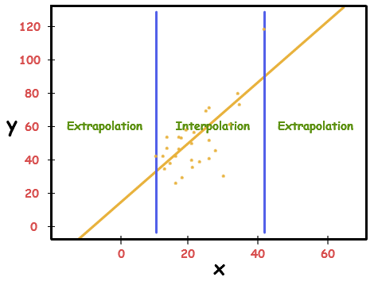

Slide 4
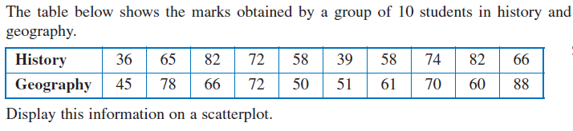
Geography
History
Notes:
Practice

Slide 5

Why is Interpolation more Accurate than Interpolation?
Write your answer on the LHS
Be prepared to share
Notes:
Closure

